Slide 1
Plenary Title Goes Here
Housekeeping Tips
Introduce yourself in the Chat box
All attendees are participating in Listen Only mode
Post your questions in the Q&A box
Webinar is being recorded and will be made available
All resources linked in the chat box will be shared in a follow-up email
Share your “bright spots and silver linings” and “keepers” in the Chat box
and on social media: #GLRKeepers

Slide 2
GLRWeek2021.gradelevelreading.net / #GLRKeepers

Slide 3
Plenary Sessions
A Virtual Gratitude Reception: CGLR Salutes Our Partners
Monday, July 26, 2021, 3–4:30 p.m. ET
Meeting the Moment: Accelerating Equitable Recovery and Transformative Change
Tuesday, July 27, 3–4 p.m. ET
Co-sponsored by Education Week and hosted on the On24 platform
Bringing Digital Equity Home: The Suncoast Digital Access for All Initiative
Wednesday, July 28, 3–4:30 p.m. ET – A Crucible of Practice Salon
The CARE Fund: A Philanthropic Initiative to Meet the Moment
Co-Sponsored by United Philanthropy Forum
Thursday, July 29, 3–4:30 p.m. ET – A Funder-to-Funder Conversation
Assume Collaboration: A Consultative Conversation on Aggregating for Impact
Friday, July 30, 2:30–4 p.m. ET (invitation only)

Slide 4
GLRWeek2021.gradelevelreading.net
Share in the Chat and connect with @Readingby3rd onTwitter and #CampaignforGLR on Facebook
to share #GLRKeepers!

Slide 5
Meeting the Moment
Accelerating Equitable Recovery and Transformative Change
Co-Sponsored with Education Week
Tuesday, July 27, 3–4 PM ET
GLRWeek2021.gradelevelreading.net / #GLRKeepers

Slide 6
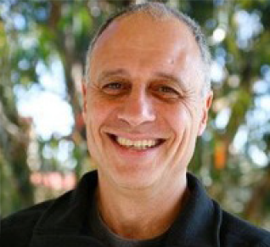
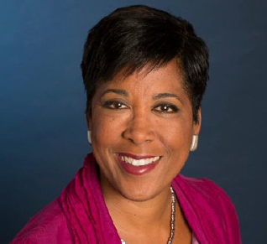
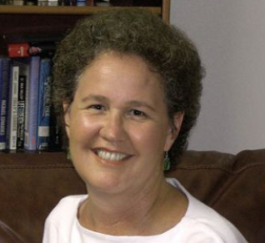
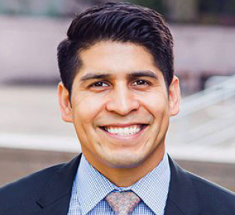
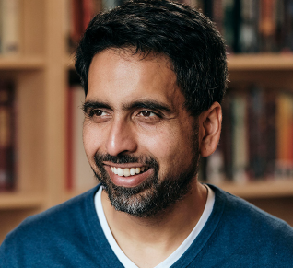
Co-Discussant
Karen Mapp, Ed.D.
Faculty Director, Education Policy and Management Masters Program
Harvard Graduate School of Education
Moderator
John Gomperts
Executive Fellow
Campaign for Grade-Level Reading
Co-Discussant
Linda Darling-Hammond, Ed.D.
President and CEO
Learning Policy Institute
Co-Discussant
Rey Saldaña
President and CEO
Communities In Schools
Co-Discussant
Sal Khan
Founder and CEO
Khan Academy
GLRWeek2021.gradelevelreading.net / #GLRKeepers
6

Slide 7
Please visit the Sessions Recordings page to view the video with our featured speakers

