Slide 1
Bringing Digital Equity Home: The Suncoast Digital Access for All Initiative
Housekeeping Tips
Introduce yourself in the Chat box
All attendees are participating in Listen Only mode
Post your questions in the Q&A box
Webinar is being recorded and will be made available
All resources linked in the chat box will be shared in a follow-up email
Share your “bright spots and silver linings” and “keepers” in the Chat box
and on social media: #GLRKeepers

Slide 2
GLRWeek2021.gradelevelreading.net / #GLRKeepers

Slide 3
Plenary Sessions
A Virtual Gratitude Reception: CGLR Salutes Our Partners
Monday, July 26, 2021, 3–4:30 p.m. ET
Meeting the Moment: Accelerating Equitable Recovery and Transformative Change
Tuesday, July 27, 3–4 p.m. ET
Co-sponsored by Education Week and hosted on the On24 platform
Bringing Digital Equity Home: The Suncoast Digital Access for All Initiative
Wednesday, July 28, 3–4:30 p.m. ET – A Crucible of Practice Salon
The CARE Fund: A Philanthropic Initiative to Meet the Moment
Co-Sponsored by United Philanthropy Forum
Thursday, July 29, 3–4:30 p.m. ET – A Funder-to-Funder Conversation
Assume Collaboration: A Consultative Conversation on Aggregating for Impact
Friday, July 30, 2:30–4 p.m. ET (invitation only)

Slide 4
GLRWeek2021.gradelevelreading.net
Share in the Chat and connect with @Readingby3rd onTwitter and #CampaignforGLR on Facebook
to share #GLRKeepers!

Slide 5
Bringing Digital Equity Home
The Suncoast Digital Access for All Initiative
A Crucible of Practice Salon
Wednesday, July 28, 3–4:30 PM ET
GLRWeek2021.gradelevelreading.net / #GLRKeepers

Slide 6
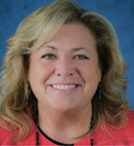

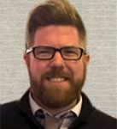
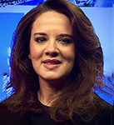
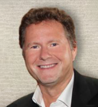
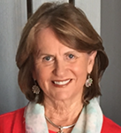
The Team
Cheri Coryea
Initiative Manager
@CCoryeaTPF
Kiarra Louis
Communications & Engagement Associate
@KLouisTPF
John Ferguson
Project Manager
@TheRealJohnFerg
Maribel Martinez
Initiative Consultant
@MMartConsult
Jake Hartvigsen
Community Engagement Lead
@JHTPF
Laurey Stryker
Initiative Consultant
@StrykerConsulti
6

Slide 7
Question of the Day
Why is digital access important to you, your community, and/or society in general?
Please enter your thoughts into the chat box!

Slide 8
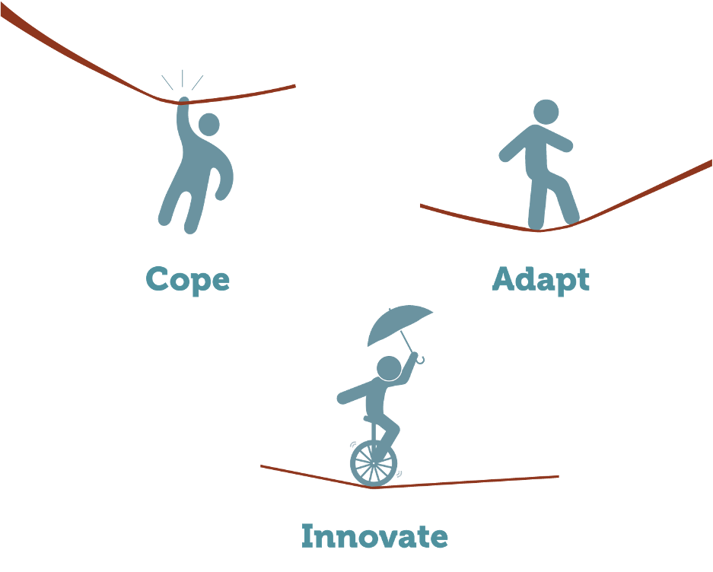

The Patterson Foundation
TPF Strengthens People, Organizations, and Communities
in ways that foster wide participation.
Charlotte
DeSoto
Manatee
Sarasota

Slide 9
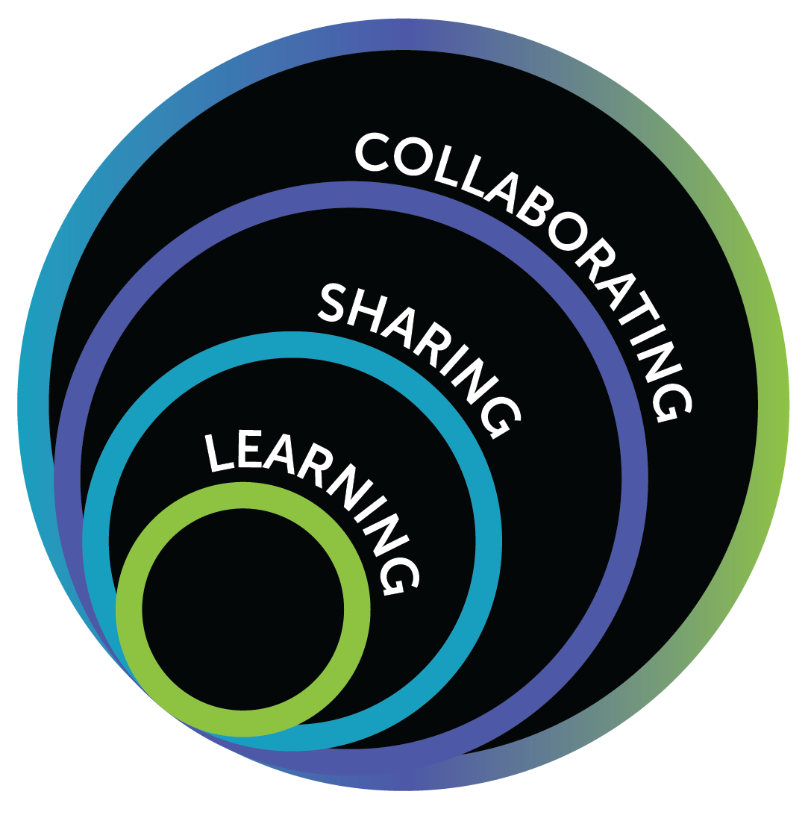
The DA4A Journey
Exploration
Local/Regional/National Perspectives & Viewpoints
Focus on ALICE Households
Two Critical Questions:
  “Who else cares?”
  “What can we do together?”
Notes:
Covid-19 Impacts on individuals, organizations & communities
June 2020
Digital Access for All initiative emerges
A focus on ALICE households and digital access
Impacts on business, non-profits, government & education
Three essential elements: Connectivity, Devices, Skills/Support

Slide 10
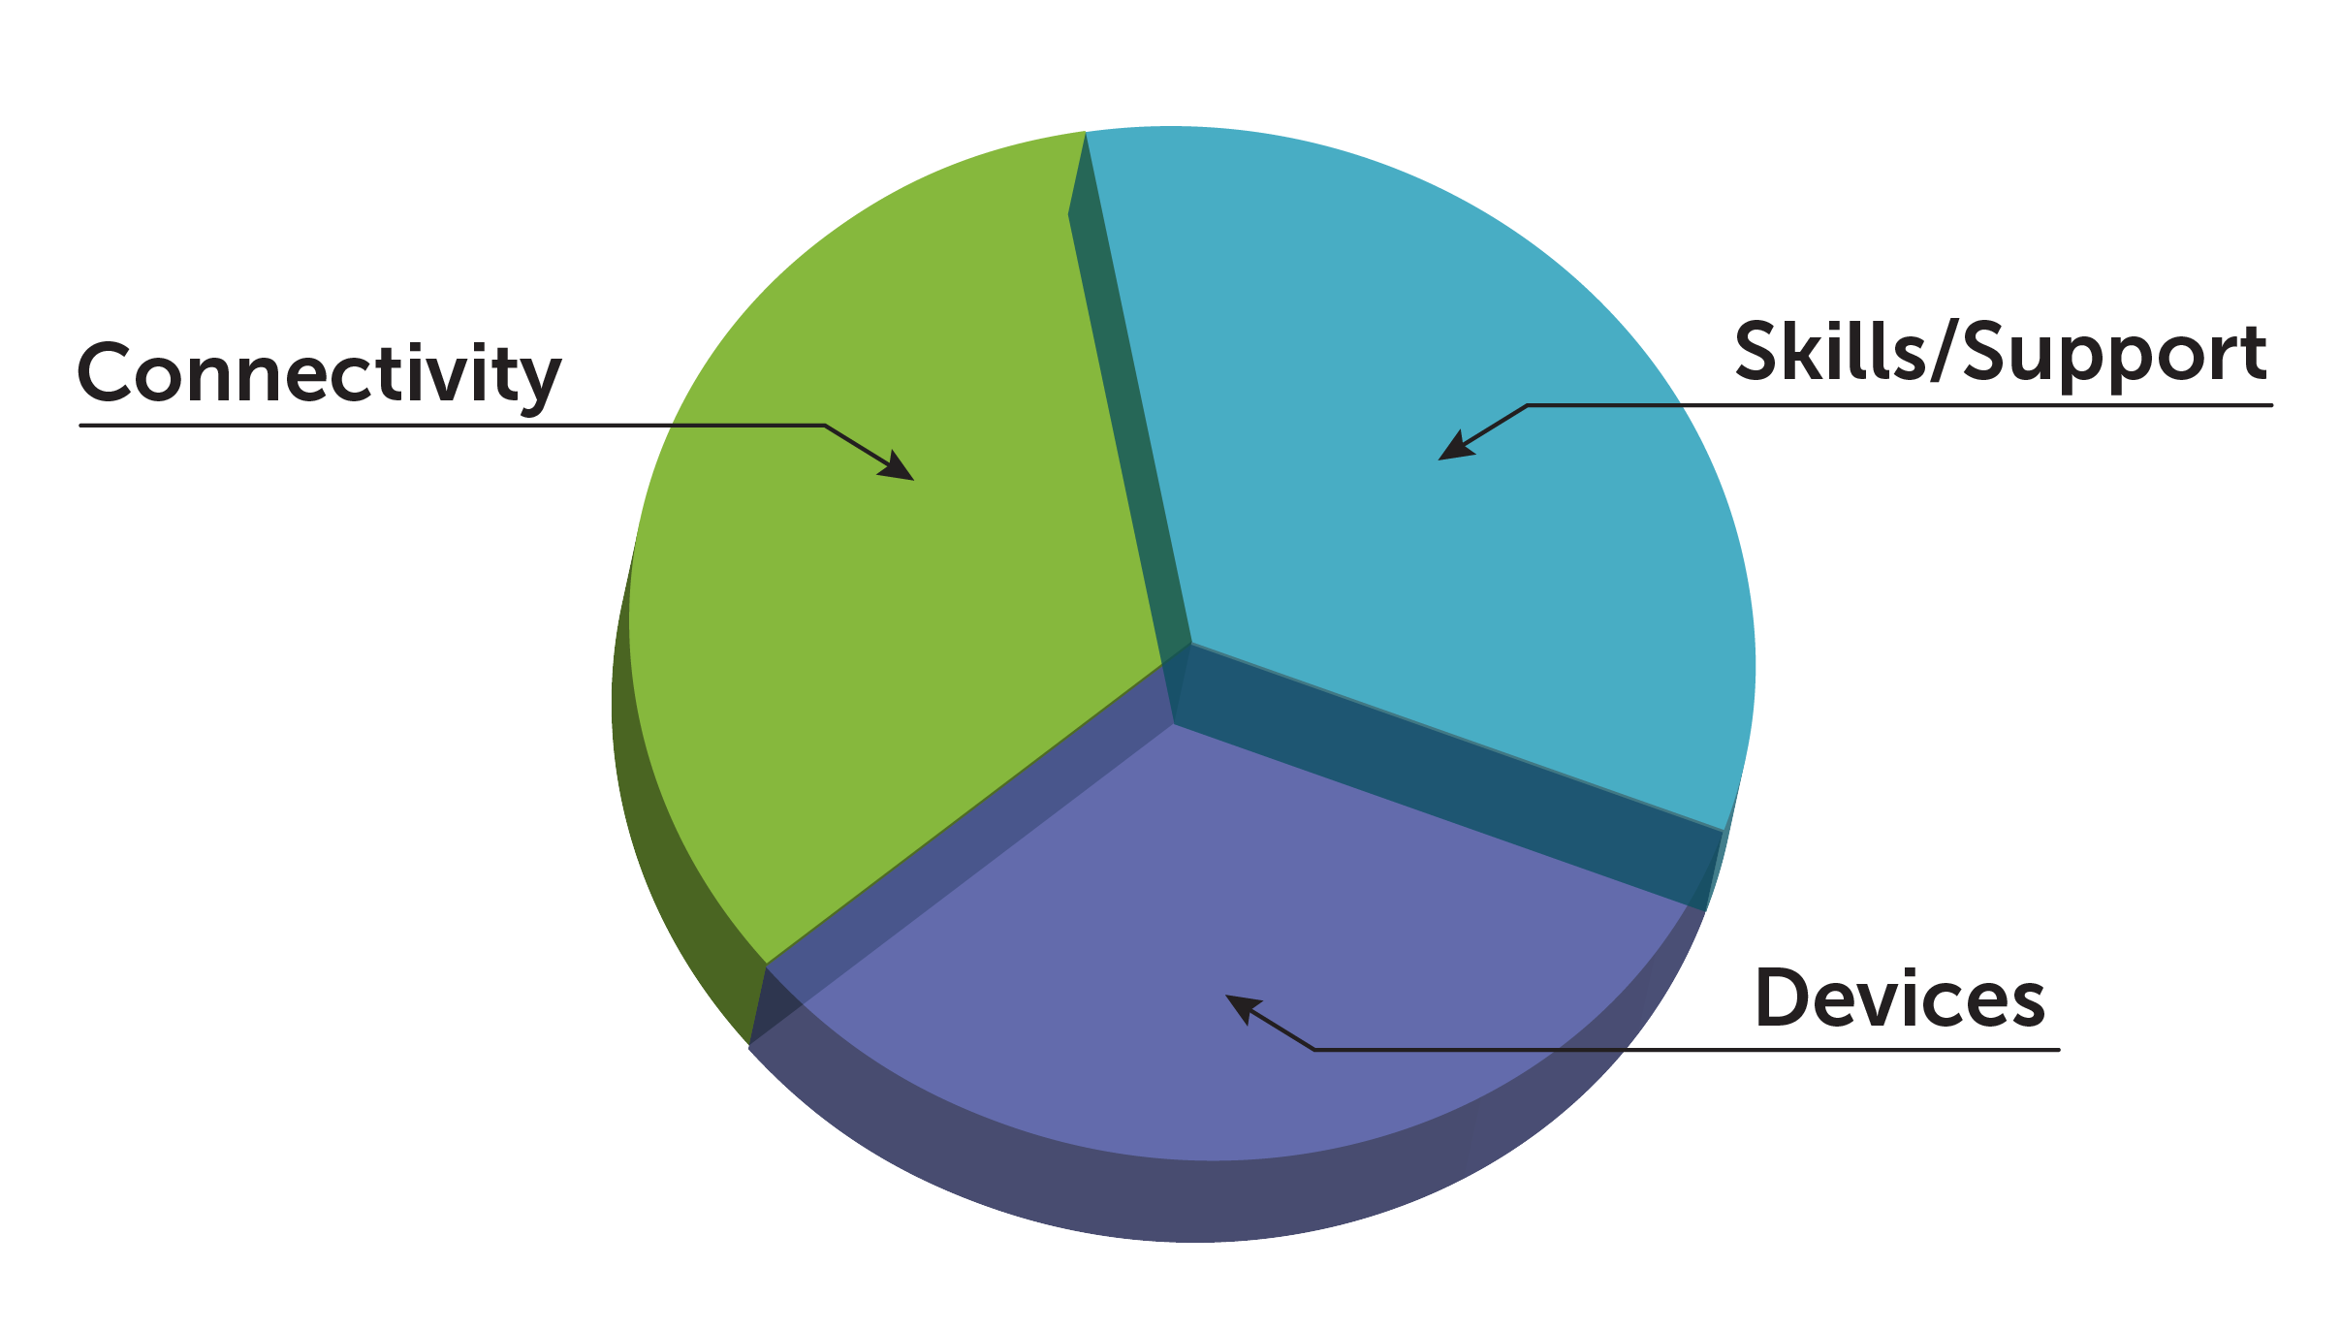
The Three Essential Elements of Digital Access

Slide 11
Learning & Sharing

Slide 12
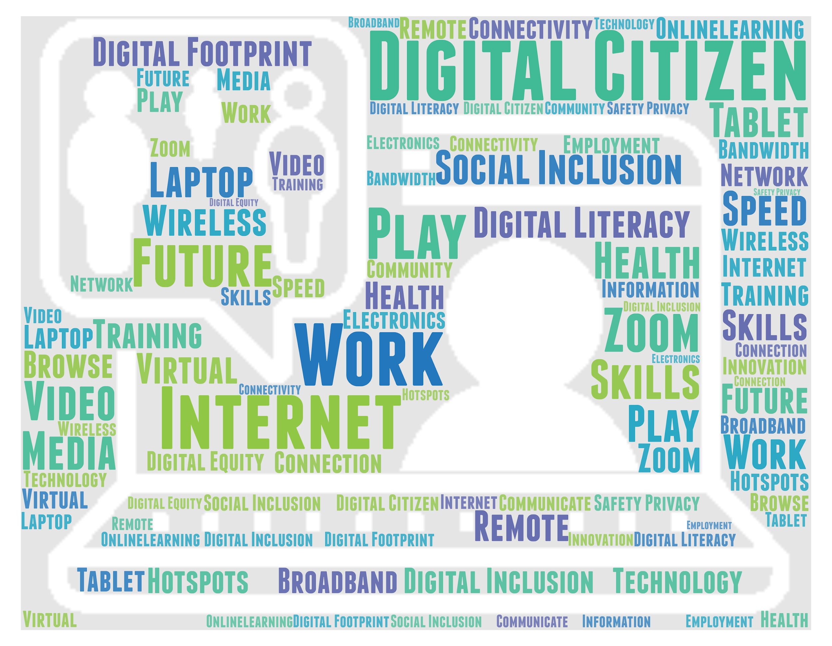
Learning
Researching documentation
Synthesizing the following key themes:
    Digital access is a basic necessity.
    Digital access requires three essential elements: Connectivity, devices, and skills and support.
    Digital access is hindered by barriers such as cost, awareness, and access.
    Digital access for those underserved and disconnected is possible as shown by efforts underway.

Slide 13

Sharing
Disseminating learning
    website, blogs, newsletters, webervations, webinars
Creating the DA4A Resource library
    PDFs, online articles, online courses, affordable services flyers, etc
    11 keywords, including but not limited to:
      Community/Regional Connectivity, Devices
      Digital Skills & Training, Education
      Health, Federal/State Government
    125+ Curated reports and resource shared

Slide 14
More Than Money: TPF’s Approach

Slide 15
Chatbox Question
What are some of the ways a funder can contribute beyond writing a check or giving a grant?
Please enter your thoughts into the chat box!

Slide 16
Funders - Beyond a Check $
Coalition Builder - Foster wide participation to strengthen impact
Backbone - Provide access to a strong network of knowledge
System Realigner - Conduct/Share research on best practices
Communicator - Community conversations toward shared aspirations
Policy Advocate - Invest to create lasting widespread Impact
Learning Agent - Connect people, organizations & community
Fundraiser - Invite others with resources to participate
Grantmaker - Expanding the $ value into more than money

Slide 17
Driving Impact
Weaving multiple sectors together by enhancing access to technology to foster inclusion and well-being
People - touching all ages and all backgrounds, especially ALICE
Business - determining needs to build digital skills
Nonprofits - enhancing ability to assist people towards available options
Government - sharing knowledge of gaps that limit access
Media - strengthening the broader effort through Aspirations Journalism
Education - closing the digital access gap as early as possible
Funders - fostering widespread inclusion to expand community solutions

Slide 18
Solutions In Action
Emphasizing/Embracing Technology for All
  Moving to the Big Tent
Gathering/Sharing information about Gaps
  Devices, Skills & Training Matrix
Promoting Pilot Programs to test the waters
  Digital Navigator Training Pilot
Connecting Community Leaders with the Community
  FCC - Emergency Broadband Benefit
  American Rescue Plan - Broadband Infrastructure

Slide 19
Digital Access Services Matrix

Slide 20
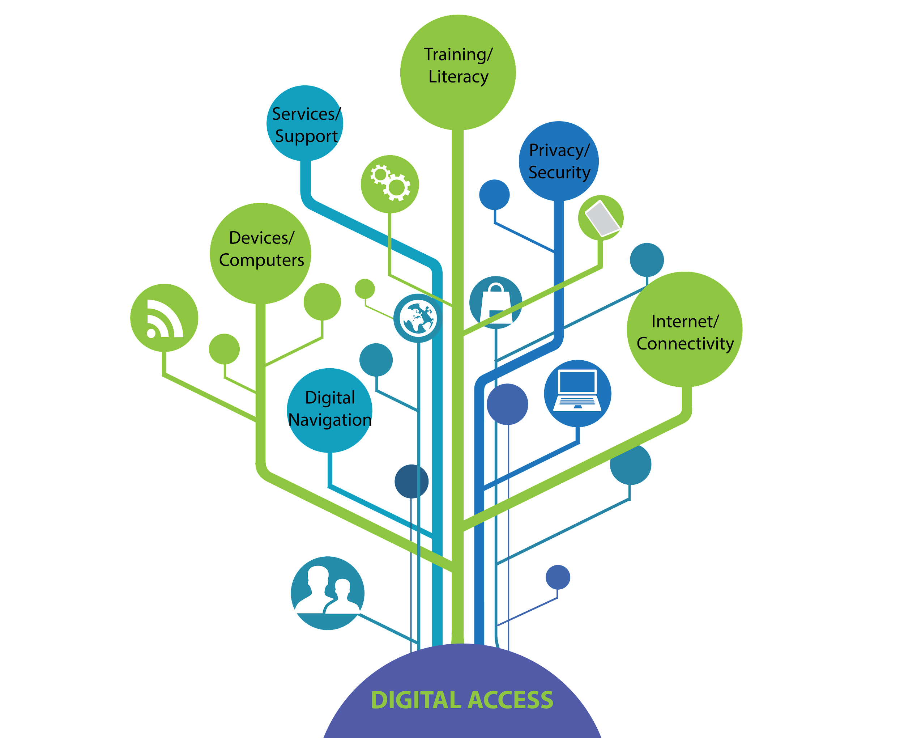
Digital Access Services Matrix
A gap in community knowledge
Developing the right tool
Surveying local organizations
Enter the Matrix
Notes:
Background: (Jake)
Review of reasons matrix was developed.
Survey sent to all collaborators
Gathered feedback and began to build out a matrix to make it a resource that all organizations can leverage.
Presentation: (Kiarra)
Present draft, working version of matrix to date.
Explain layout (3 legs plus Digital Navigator section).
Purpose of matrix: to provide a “go-to” resource or “one stop shop” for organizations to use in identifying resources and partners who can help meet their constituents’ needs.
Helps identify existing gaps in the region to help organizations, foundations, and different individuals see what areas really need support.

Slide 21
Digital Navigator Pilot

Slide 22
Framing the Pilot Program
COVID-19 > SCGLR > DA4A
Internet connectivity, computers, and digital skills are more essential than ever
Perception of technology > reticence
About 60,000,000 are without internet in the U.S. due to its cost
Future uncertainty requires trusted support to engage in digital life
Notes:
Pew Research Center
Worries about life in 2025
Inequality and injustice are magnified
As risk grows, security must also;
privacy falls and authoritarianism rises
Threats to work will intensify from automation, artificial intelligence, robotics and globalization
Misinformation will be rampant
People’s mental health will be challenged

Slide 23
About Digital Navigators
Emerged nationally as an agnostic role to support those impacted by the digital divide
  agile, community-based customer service touch point
  trained to help consumers select from low-cost internet plans, choose the right affordable computing devices to suit lifestyles, and either directly provide or provide access to digital literacy training and advancing digital skills
Digital Navigator training is an allowable ARPA expense
Notes:
empathic, independent self-starter, responsive, solutions-oriented

Slide 24
Emergence of the Pilot
Collaboration and learnings from DA4A
  local agencies realized/understood the need for digital inclusion but were unsure of how to support constituents with internet, devices, and training
    DA4A community partner orgs serve the same people in the community
    DA4A community partner orgs tackle similar roadblocks to serving customers tracing back to issues with digital access
Notes:
TPF became interested in supporting the Digital Navigator pilot because trainees would be able to address the three legs of the digital access stool - connectivity, devices, and training - for participating orgs and the larger community

Slide 25
Community Partner Panel Discussion

Slide 26
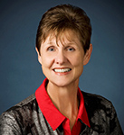
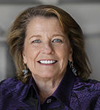

Community Partner Panel
Community Partner
Margie Genter
Vice President of Mission Services
Goodwill Manasota
Community Partner
Lori Aberle Gentile
Client Services Director
Women’s Resource Center
Community Partner
Lisbeth Oscuvilca
Family Engagement Director
UnidosNow
26

Slide 27
Thank You!

Slide 28
State Events
Visit our new conference site to find out how dozens of states and communities confronted by COVID-19 stepped up to meet the moment.
http://glrweek2021.gradelevelreading.net/state-events/

Slide 29
Plenary Sessions
A Virtual Gratitude Reception: CGLR Salutes Our Partners
Monday, July 26, 2021, 3–4:30 p.m. ET
Meeting the Moment: Accelerating Equitable Recovery and Transformative Change
Tuesday, July 27, 3–4 p.m. ET
Co-sponsored by Education Week and hosted on the On24 platform
Bringing Digital Equity Home: The Suncoast Digital Access for All Initiative
Wednesday, July 28, 3–4:30 p.m. ET – A Crucible of Practice Salon
The CARE Fund: A Philanthropic Initiative to Meet the Moment
Co-Sponsored by United Philanthropy Forum
Thursday, July 29, 3–4:30 p.m. ET – A Funder-to-Funder Conversation
Assume Collaboration: A Consultative Conversation on Aggregating for Impact
Friday, July 30, 2:30–4 p.m. ET (invitation only)

Slide 30


@readingby3rd
@CampaignforGLR
#GLRKeepers
GLRWeek2021.gradelevelreading.net

