Slide 1
Plenary Title Goes Here
Housekeeping Tips
Introduce yourself in the Chat box
All attendees are participating in Listen Only mode
Post your questions in the Q&A box
Webinar is being recorded and will be made available
All resources linked in the chat box will be shared in a follow-up email
Share your “bright spots and silver linings” and “keepers” in the Chat box
and on social media: #GLRKeepers

Slide 2
GLRWeek2021.gradelevelreading.net / #GLRKeepers

Slide 3
Plenary Sessions
A Virtual Gratitude Reception: CGLR Salutes Our Partners
Monday, July 26, 2021, 3–4:30 p.m. ET
Meeting the Moment: Accelerating Equitable Recovery and Transformative Change
Tuesday, July 27, 3–4 p.m. ET
Co-sponsored by Education Week and hosted on the On24 platform
Bringing Digital Equity Home: The Suncoast Digital Access for All Initiative
Wednesday, July 28, 3–4:30 p.m. ET – A Crucible of Practice Salon
The CARE Fund: A Philanthropic Initiative to Meet the Moment
Co-Sponsored by United Philanthropy Forum
Thursday, July 29, 3–4:30 p.m. ET – A Funder-to-Funder Conversation
Assume Collaboration: A Consultative Conversation on Aggregating for Impact
Friday, July 30, 2:30–4 p.m. ET (invitation only)

Slide 4
GLRWeek2021.gradelevelreading.net
Share in the Chat and connect with @Readingby3rd onTwitter and #CampaignforGLR on Facebook
to share #GLRKeepers!

Slide 5
A Virtual Gratitude Reception
CGLR Salutes Our Partners
Monday, July 26, 3–4:30 PM ET
GLRWeek2021.gradelevelreading.net / #GLRKeepers

Slide 6
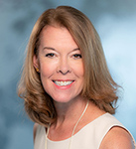
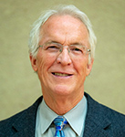
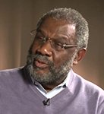
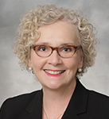
Keynote Speaker
Suzanne McCormick
U.S. President
United Way Worldwide
Speaker
Doug Linkhart
President
National Civic League
Speaker
Ralph Smith
Managing Director
Campaign for Grade-Level Reading
Speaker
Becky Miles-Polka
Senior Consultant
Campaign for Grade-Level Reading
GLRWeek2021.gradelevelreading.net / #GLRKeepers
6

Slide 7
Video Recording
GLRWeek2021.gradelevelreading.net / #GLRKeepers

Slide 8
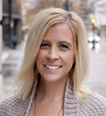
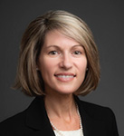
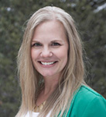
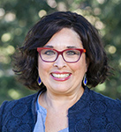
State Leaders
Speaker
Amy Ahrens Terpstra
Vice President of Collective Impact Partnerships
United Way of Salt Lake
Speaker
Jennifer Deemer
Vice President of Community Impact
United Way of Wyoming Valley
Speaker
Kayla Klein
Black Hills Reads Director
United Way of the Black Hills
Speaker
Adrianna Cuéllar Rojas
President and CEO
United Ways of Texas
GLRWeek2021.gradelevelreading.net / #GLRKeepers
8

Slide 9
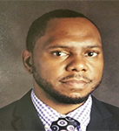
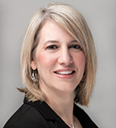
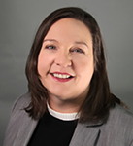
State Leaders
Speaker
Ken Livingston
Director
Get Delaware Reading
United Way of Delaware
Speaker
Jill Pereira
Vice President-Education and Impact
United Way of the Greater Lehigh Valley
Speaker
Susan Patrick
Director of Childhood Success
United Way of Southwest Virginia
GLRWeek2021.gradelevelreading.net / #GLRKeepers
9

Slide 10
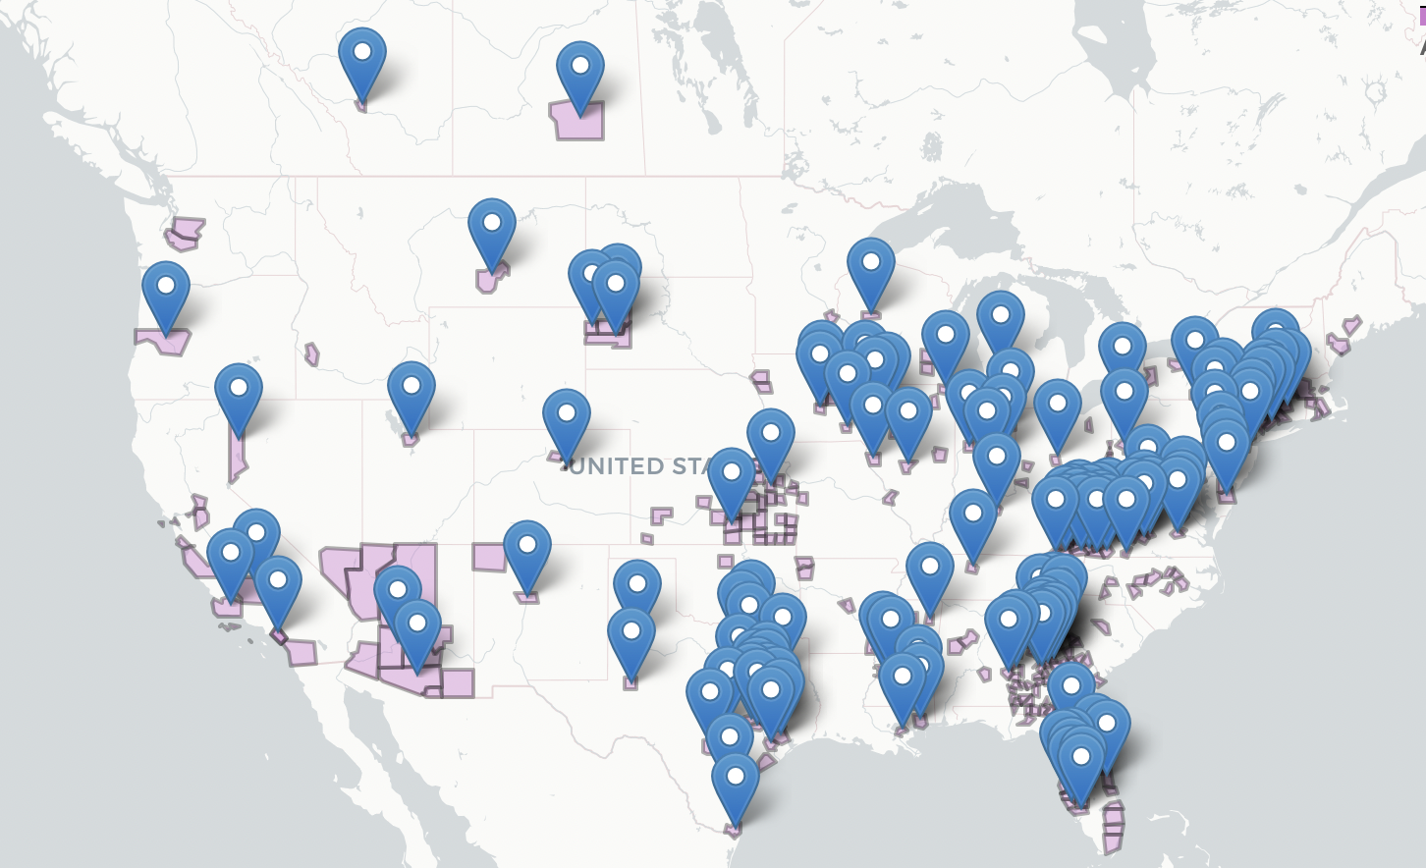
United Ways Are an Integral Part of CGLR’s Reach
GLRWeek2021.gradelevelreading.net / #GLRKeepers
Notes:
The shaded areas represent the counties served by coalitions with a United Way as a member
The pins represent the counties served by coalitions where United Way is a community lead organization (in some cases, a coalition serves more than one county. All counties served by a coalition with a UW as a community lead will have a pin)

Slide 11
United Ways Are an Integral Part of CGLR’s Reach
205 United Ways are members of GLR coalitions in 45 states, the Virgin Islands, Puerto Rico and both Canadian Provinces that are part of the
GLR Network
103 United Ways serve in Community Lead roles and act as a backbone and convener of GLR coalition work in their community
Six states have United Ways serving in State Lead roles
  Delaware, Pennsylvania, South Dakota, Texas, Utah, Virginia
GLRWeek2021.gradelevelreading.net / #GLRKeepers

Slide 12
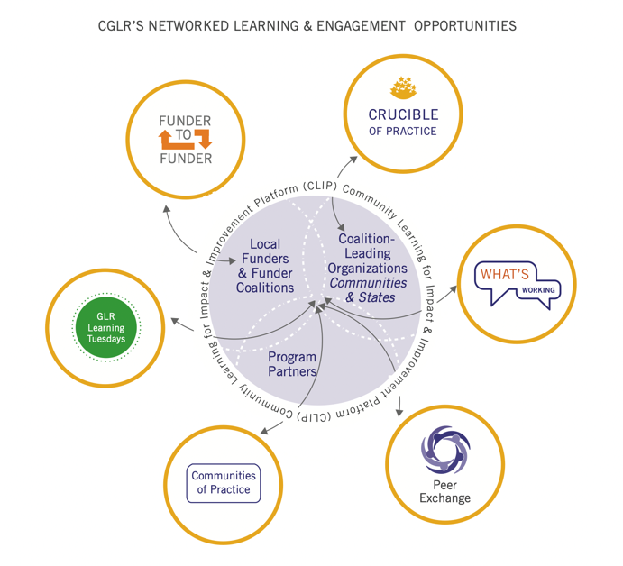
United Ways Are a Regular Presence Across CGLR’s Learning and Engagement Opportunities
105 of 205 United Ways in CGLR (51%) have at least one subscriber on CLIP
683 people representing 256 United Ways and UWW have registered or attended at least one LEO webinar since Sept. 2019, representing 5,200+ unique registrations or attendees
  32 people representing United Way have served as presenters, moderators and/or commentators across webinars
GLRWeek2021.gradelevelreading.net / #GLRKeepers

Slide 13

Bright Spots & Silver Linings
Campaign for Grade-Level Reading Gratitude Reception
July 2021

Slide 14
211 Notable Contact Data
2019
Phone Calls: 11,029,047
Texts: 278,899
Web Chat: 102,856
E-mail: 48,040
Total Contacts: 11,456,369
Spanish: 398,302
2020
Phone Calls: 18,507,610
Texts: 1,174,128
Web Chat: 175,813
E-mail: 160,703
Total Contacts: 20,018,254
Spanish: 1,870,077

Slide 15
211 Connections Made
2019
3M Housing
2.1M Utilities
1.5M Food
1.4M Mental Health
1.4M Legal/Public Service
Total Connections: 14.5M
2020
7.2M COVID-19
3.8M Housing
3.7M Food
2.3M Healthcare
2.2M Utilities
Total Connections: 27.8M

Slide 16
Financial Assistance
1.2M Connections to Financial Assistance & Coaching
Made nearly 350K connections to tax preparation assistance programs including scheduling nearly 175K VITA appointments

Slide 17
Education & Employment
170K connections to finding and getting good jobs
160K connections to education resources

Slide 18
Safety
Addressed nearly 115K requests for help related to sexual assault and domestic violence
Made nearly 6K connections to human trafficking information and support services
10 211s answer their local human trafficking hotline
16 211s answer their local domestic violence hotline

Slide 19
Other Notables
Performed more than 121K intakes for homeless shelters
Addressed more than 75K requests for veterans’ services
Provided support for more than 470K callers experiencing suicide ideation or a mental health crisis.
Made more than 285K connections to transportation services, including dispatching/scheduling 25K rides
80K connections to volunteering/making a donation

Slide 20
The 211 network responded to more than 20 million requests of for help by phone, text, email and chat. This is up from 11.5 million requests in 2019.
211s made 27.8 million connections to critical services and help. This is up nearly 100% from the 14 million connections in 2019.

Slide 21
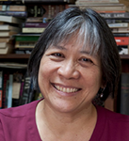
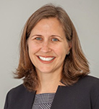
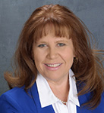
United Ways Address Chronic Absence
Speaker
Hedy Chang
Executive Director
Attendance Works
Speaker
Tricia Johnson
Director of Education Initiatives
United Way of Greater Kansas City
Speaker
Dawn Gerundo
Community Development and Engagement Director, Valley of the Sun United Way
GLRWeek2021.gradelevelreading.net / #GLRKeepers

Slide 22

The Chronic Absence Journey
From little known concept to national education metric
Release of groundbreaking report: Present, Engaged and Accounted For, co-authored by Hedy Chang and inspired by Ralph Smith, report first documents the attendance challenge for young students, defines 10% tipping point when absence affects student achievement and coins term “chronic absence”.
2008
Founding of Attendance Works (AW) as a national initiative dedicated to advancing student success and narrowing equity gaps through addressing chronic absence.
2010
Emerging Bright Spots
Local efforts, including from local GLR campaigns, show reducing chronic absence is possible. AW nurtures and documents successes.
NASAPP (Network for Advancing State Attendance Policies and Practices) founded by AW to promote peer dialogue and learning across states.
2013
Launch of Attendance Awareness Campaign by AW. CGLR, UWW and key partners. It expands public understanding of chronic absence and advances effective strategies for improving attendance.
2013

Slide 23



The Chronic Absence Journey
From little known concept to national education metric
Every Student Succeeds Act: Success stories across the country and in multiple states results in new federal legislation (ESSA) requiring reporting of chronic absence report.
2015
Head Start Performance guidelines requires sites to monitor and address chronic absence among participants. Decision informed by research catalyzed by AW.
2016
Chronic absence widely adopted as accountability metric by 36 states and the District of Columbia in their state ESSA implementation plans. Action supported by AW brief and NASAPP.
2017
AW Reach Grows: Website visitors exceed 450,000.
American Academy of Pediatrics issues attendance policy statement for which AW was an advisor.
2019
ESSA Waivers Require Public Reporting of Disaggregated Chronic Absence Data. In keeping with AW recommendations, this requirement was conveyed in a February 2021 memo from the U.S. Department of Education.
2021
.

Slide 24
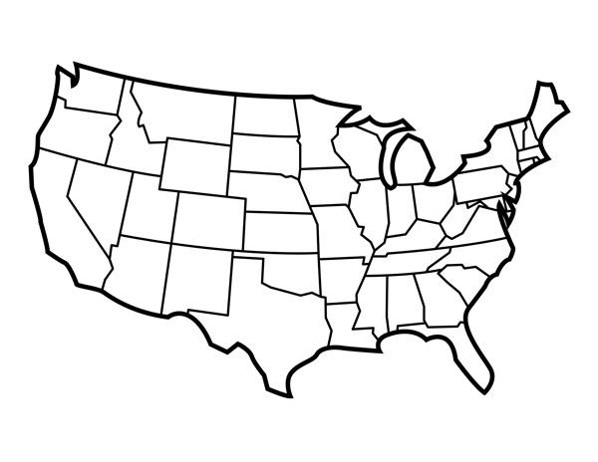
United Way Worldwide Helped Put Chronic Absence on the National Map
Served as a convening partner in the national Attendance Awareness Campaign.
Used its robust communications and network to promote awareness and disseminate best practices.
Hosted Attendance Awareness Campaign webinars for the first 6 years of our national Attendance Awareness Campaign.

Slide 25
How have local United Ways Made a Difference?
(A few examples)
Advanced Attendance Awareness Campaigns
Analyzed Chronic Absence Rates
Examples: United Way of Southwestern Pennsylvania Be There Campaign; United Way Quad Cities Challenge 5
Data
Examples: United Way of Salt Lake helps local districts and schools analyze chronic absence data.
Awareness
Organized Peer Learning Networks
Offered TA to School Districts
PLNs
Examples: Valley of the Sun United Way creates regional PLN, United Way of Greater Kansas City helps districts establish PLNs.
TA
Examples: United Way of Southwest Virginia offers TA, mini-grants, data reporting and resource compass; United Way of Texas supports consultation to districts.
Hosted Attendance Summits
Helped Families Meet Needs and Keep Kids Learning
Summits
Examples: United Way of the Midlands & United Way of the Plains
Covid 19
Examples: Mile High United Way (parent engagement); United Way of Delaware (2-1-1 hotline)

Slide 26

Valley of the Sun United Way (VSUW) & United Way of Greater Kansas City (UWGKC)
Panelists
Dawn Gerundo, Community Development and Engagement Director, VSUW
Tricia Johnson, Director, Education Initiatives, UWGKC
      Why did your United Way get involved in addressing chronic absence?
      What have you done? What has been a bright spot?
      What is something you plan to carry forward in your work?

Slide 27
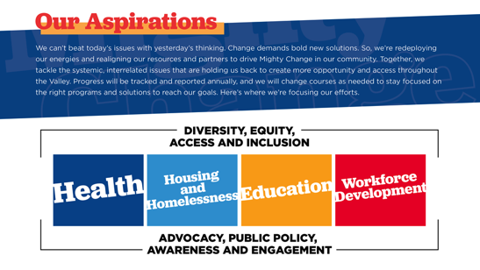


Slide 28
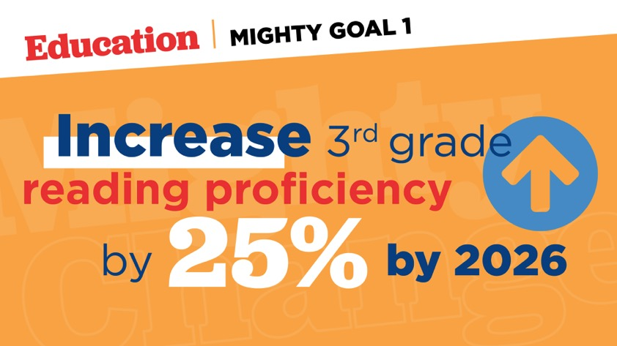
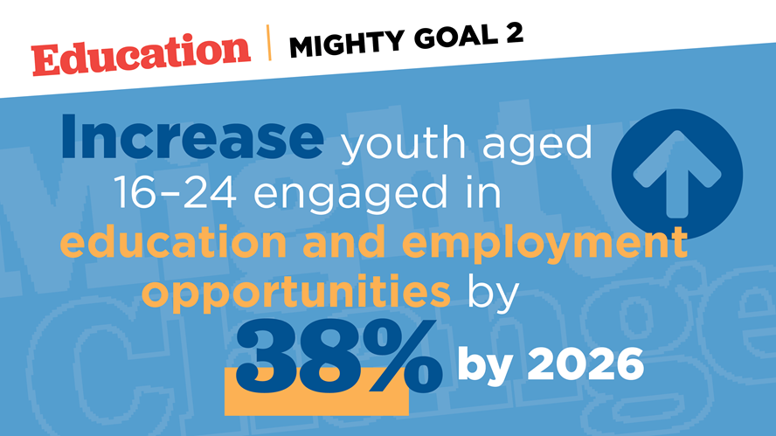

Slide 29

Looking Back:
DATA
  How was it being collected
  Awareness to the difference between “Average” and “Individual” attendance
RELATIONSHIPS
  School District
    Started Cohort of Learning
    Customized data plans
    Pilot Schools
    Policy Changes
  Community
    Lead Awareness Strategies
    Call for Action (Example: Work with Public Housing to engage Attendance Angels)
CONTINOUS IMPROVEMENT
  Data Reviewing
  Strategizing
  Sustainability

Slide 30
Bright Spots:
We saw our pilot school a reduction in chronic absenteeism rates by 50% over two years.
We saw district wide a move from 18% to down to 11% (our goal was to be under 10%) of students being chronically absent
We saw growth in our reading scores, parent participation and the strengthen of a community.
During COVID this one district share families were remaining in contact with them, whereas others around were struggling.

Slide 31
What’s Next
Review our data.
Adjust to the ever-changing landscape for our families.
  Provided them with more resources and solutions
  Added Social Workers to our Schools
  Increase SEL in our schools
We work together to develop our plan
  Use our strengths to go deeper
  Learn from what did and didn’t work
  Continue to bring awareness
  Use our data to direct us.

Slide 32
Student Attendance Initiative
United Way of Greater Kansas City

Slide 33
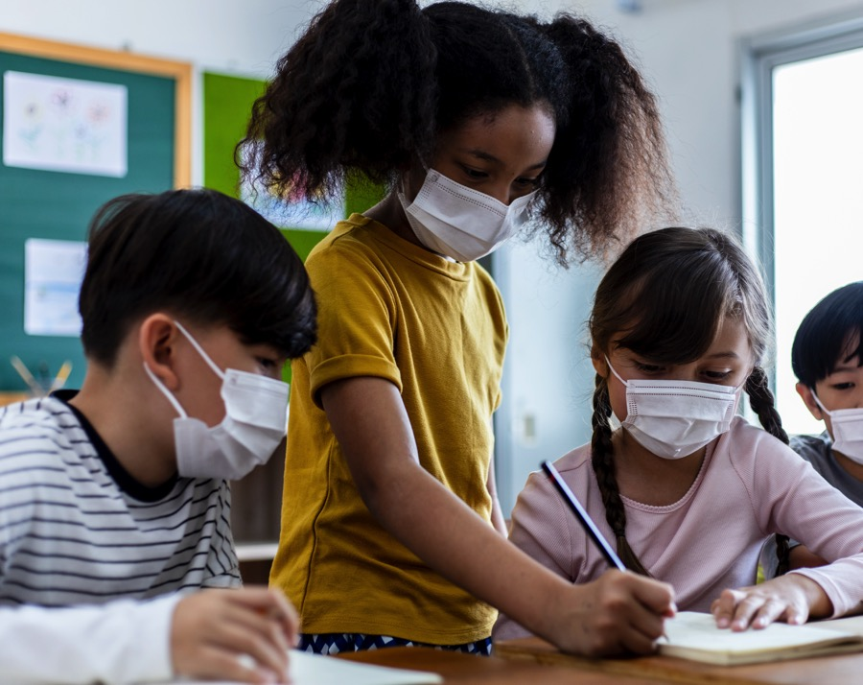
Why Student Attendance?
Poor attendance is correlated with a host of negative outcomes across the K-12 trajectory and beyond.
In 2018, United Way of Greater Kansas City set a goal of reducing chronically absent students in the Kansas City metro by one-third by 2028.
300,000 students in 500 public schools
Notes:
Student attendance is a leading indicator of educational equity and inequity.

Slide 34
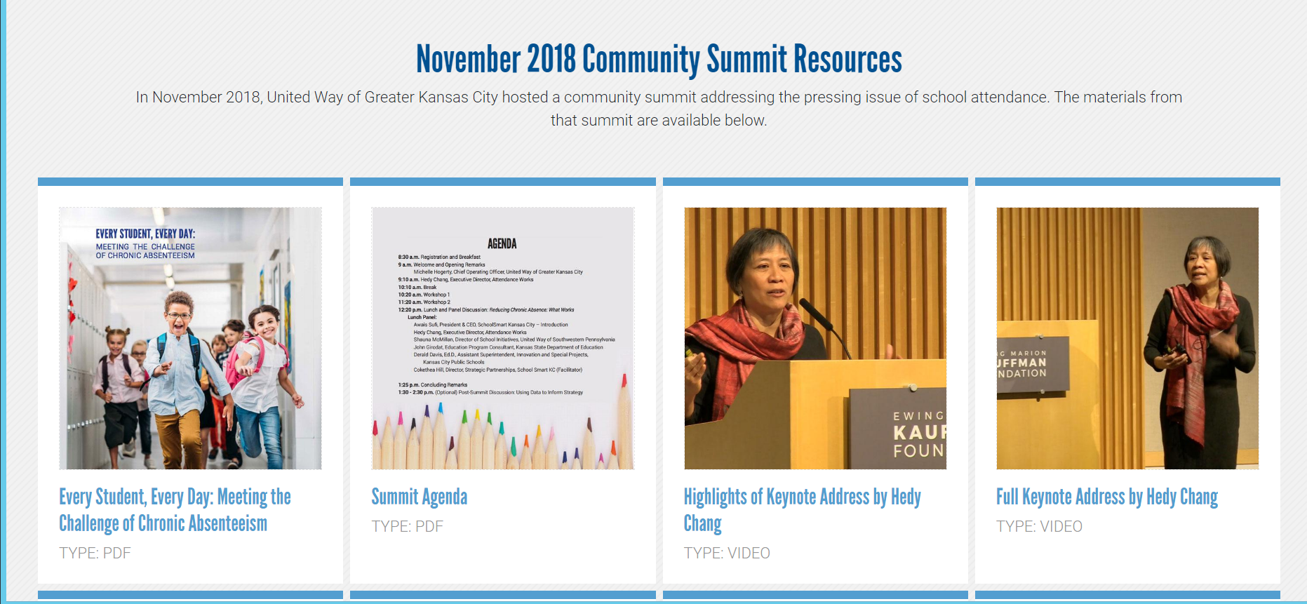
Raise Community Awareness

Slide 35



Establish Peer Learning Networks
Year 2
Year 1
Year 3
Training curriculum: Four sessions
Coaching visits
Data analysis – parsing patterns and trends
Developing and executing local implementation plans
Development and support of local attendance teams.
Notes:
Looked for schools with strong leaders and senior leadership’s commitment

Slide 36
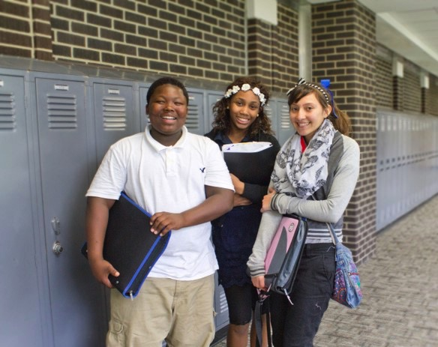
Promising Results
In Hickman Mills, three-quarters of the moderately chronically absent students had improved their attendance, including 61% who were no longer considered chronically absent.

Slide 37
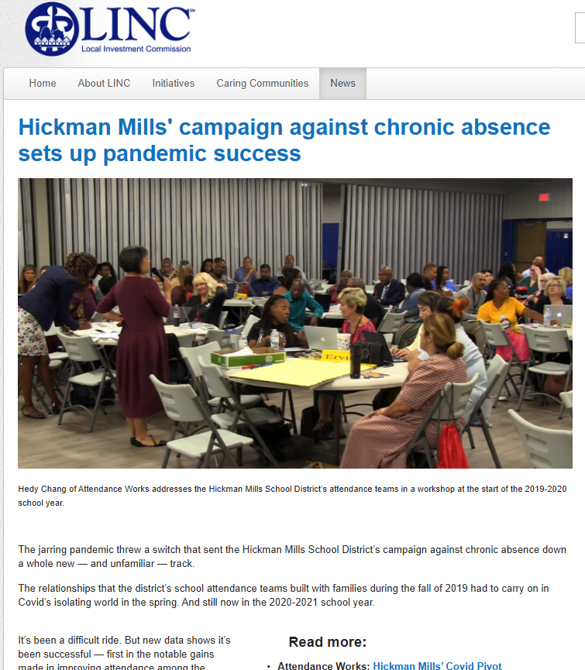
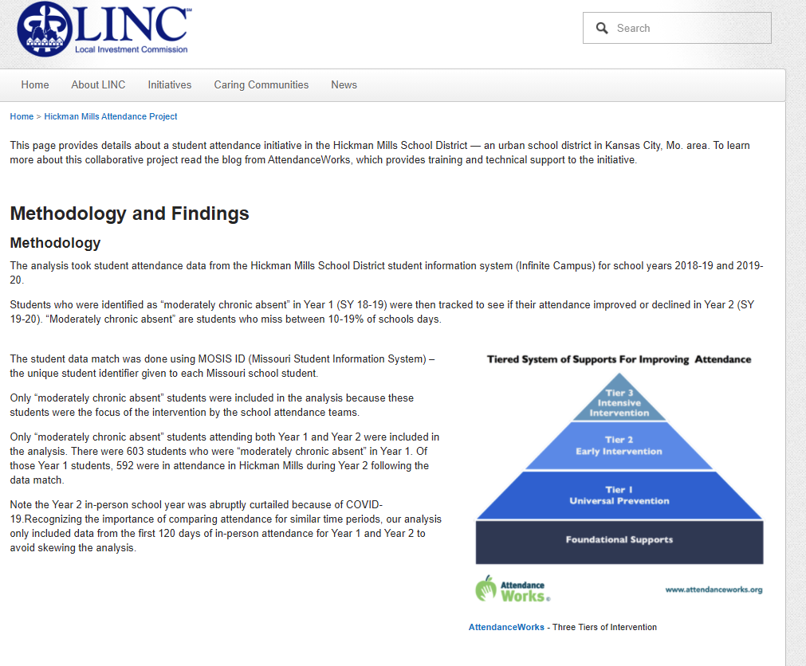
https://kclinc.org/news/2020/10/26/hickman-mills-campaign-against-chronic-absence-sets-up-pandemic-success

Slide 38




Partner on Student Attendance Campaign
In partnership with…

Slide 39
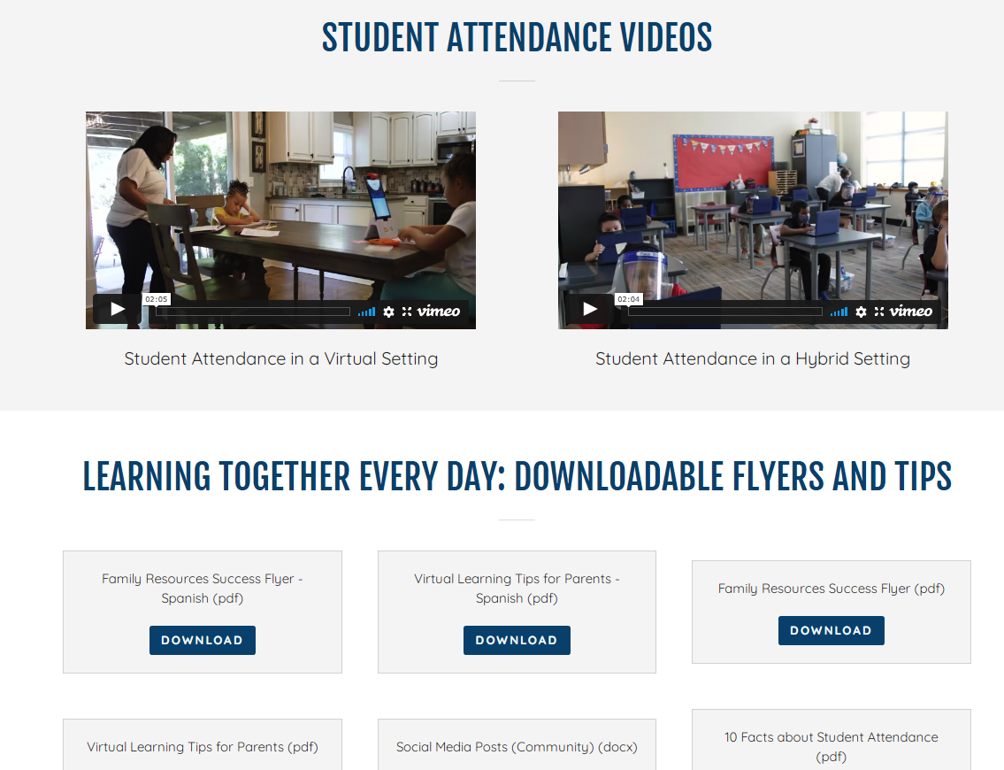

https://turnthepagekc.org/school-attendance

Slide 40

What’s Next?
Expand district partnerships
Support current district partners (committed for 3 years)
Support Turn the Page KC’s growth as local technical expert
Attendance Works remains a valuable partner

Slide 41

A Call to Continued Action
To return students to consistent learning during Covid-19 recovery, it will become even more critical to:
  Adopt positive, not punitive, attendance strategies.
  Invest in data systems that monitor attendance data for in-person and remote settings
  Participate in research to establish early warning indicators of disengagement in distance and hybrid learning
  Engage families in understanding and solving attendance barriers
  Promote interagency and community collaboration and coordination.

Slide 42
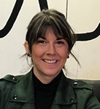
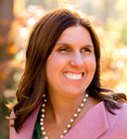
United Ways Partner With Vision To Learn
Speaker
Kate Bennett
Community Impact Officer-Education United Way of Central Iowa
Speaker
Corinne Kroger
Iowa Regional Director
Vision To Learn
GLRWeek2021.gradelevelreading.net / #GLRKeepers
42

Slide 43
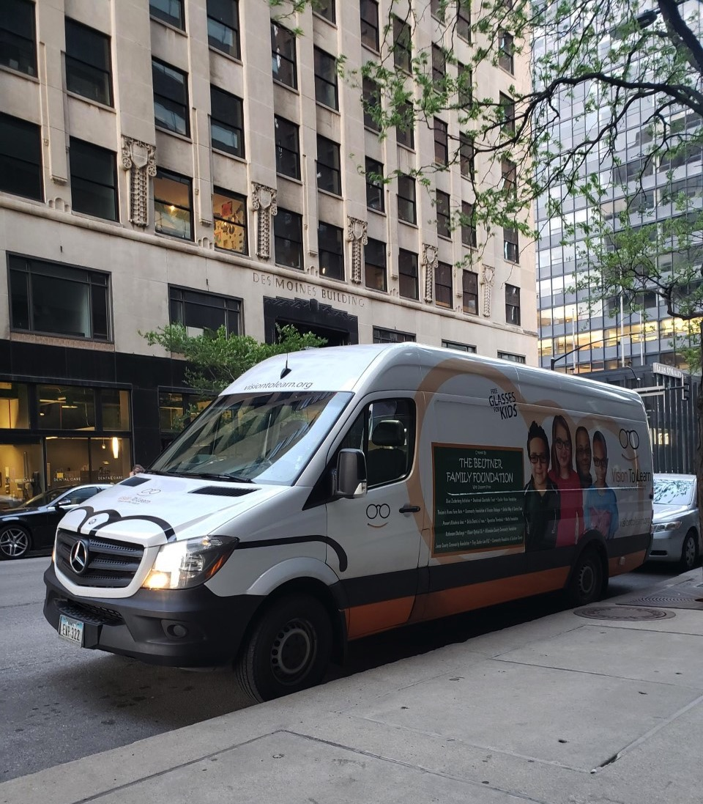



Slide 44

The Problem
1 in 4
80%
95%
2 million
3rd graders
12 months
students have vision problems that can affect their ability to achieve in school and engage in life
of all learning in a child's first 12 years occurs visually
of students in underserved communities do not have the glasses that they need
children in America lack the glasses they need to read a book, see the board or participate in class
who are not proficient in reading are more likely to drop out of school
Of learning loss is estimated for students due to the impacts of COVID-related shutdowns, considered to be a "generational loss."

Slide 45
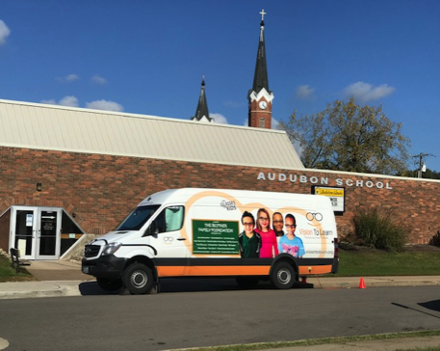
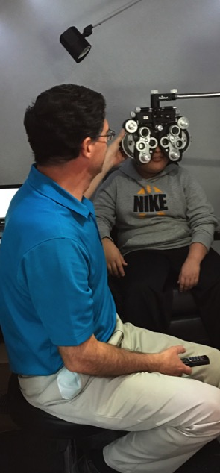
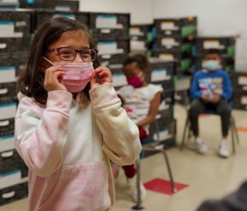
The Solution
Vision To Learn provides access to vision care by providing exams and glasses, free of charge, to students in need.
Bringing the mobile clinic directly to schools and organizations, removes many barriers for families who normally would not be able to get the vision care they need for their student.

Slide 46

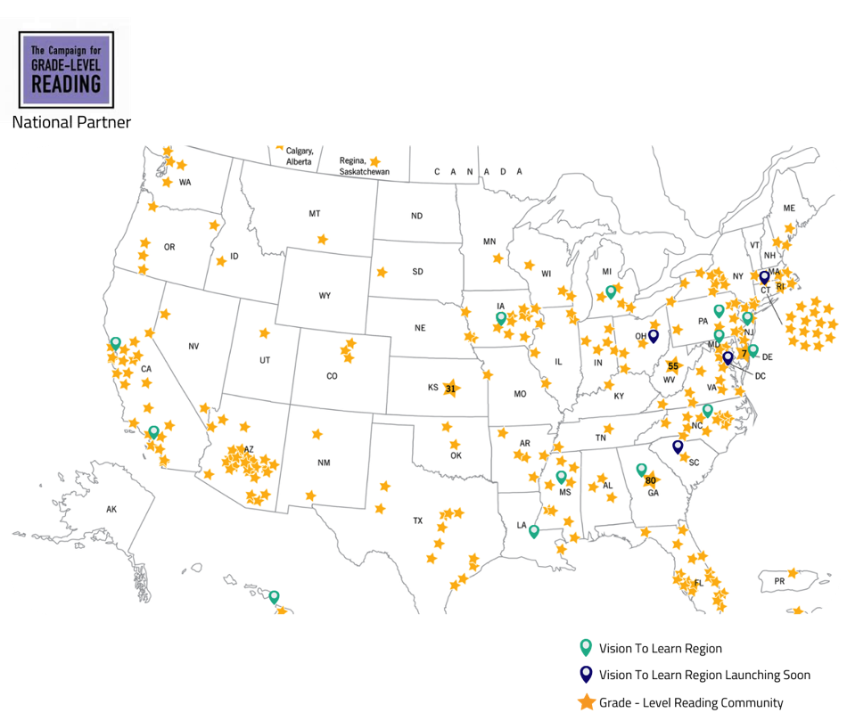
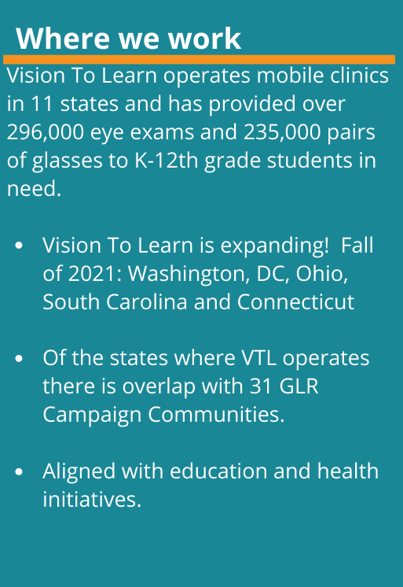

Slide 47
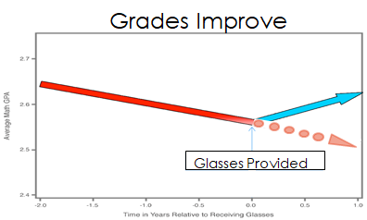
Measurable Results
UCLA Study
  The study found that before getting glasses, students’ math GPAs were declining, but after glasses that trajectory was reversed. Grades in reading also showed an improved trajectory after students received glasses.
John Hopkins University Wilmer Eye Institute
  providing students with glasses accelerates their gains on English Language Arts standardized tests, comparable to an extra month of class time.
  Students with Individual Education Plans and those scoring in the lowest quartile improved even more – the equivalent of three months of class time.

Slide 48
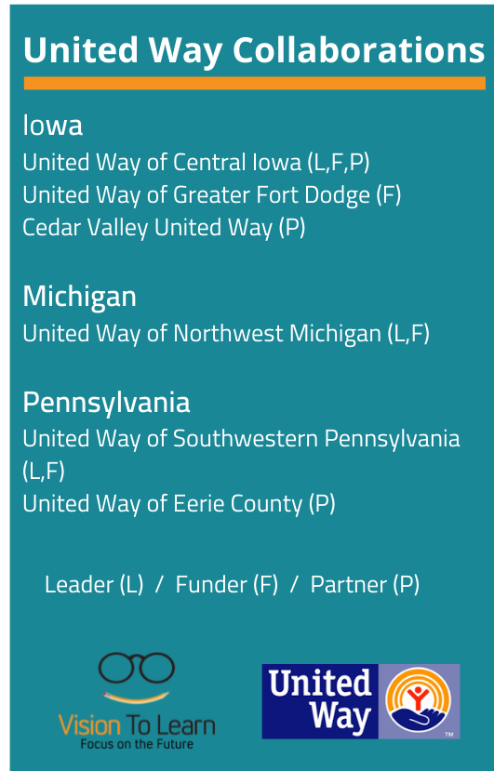
Strong Partnerships Create Bigger Impact
Goes beyond program implementation and promotes systems change:
Awareness Building
Bridge to health and education networks
Philanthropic support
Advocacy and connection to policy work

Slide 49
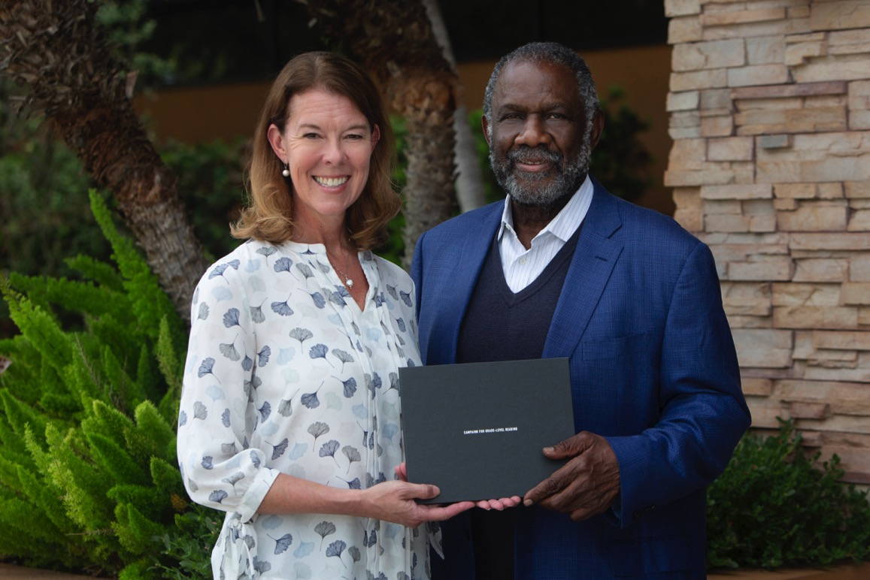
2021 CGLR Pacesetter: United Way Worldwide
GLRWeek2021.gradelevelreading.net / #GLRKeepers

Slide 50
In Closing … Looking Forward to 2022
Doug Linkhart
President
National Civic League
GLRWeek2021.gradelevelreading.net / #GLRKeepers

Slide 52
State Events
Visit our new conference site to find how dozens of states and communities confronted by COVID-19 stepped up to meet the moment.
http://glrweek2021.gradelevelreading.net/state-events/

Slide 53
Plenary Sessions
A Virtual Gratitude Reception: CGLR Salutes Our Partners
Monday, July 26, 2021, 3–4:30 p.m. ET
Meeting the Moment: Accelerating Equitable Recovery and Transformative Change
Tuesday, July 27, 3–4 p.m. ET
Co-sponsored by Education Week and hosted on the On24 platform
Bringing Digital Equity Home: The Suncoast Digital Access for All Initiative
Wednesday, July 28, 3–4:30 p.m. ET – A Crucible of Practice Salon
The CARE Fund: A Philanthropic Initiative to Meet the Moment
Co-Sponsored by United Philanthropy Forum
Thursday, July 29, 3–4:30 p.m. ET – A Funder-to-Funder Conversation
Assume Collaboration: A Consultative Conversation on Aggregating for Impact
Friday, July 30, 2:30–4 p.m. ET (invitation only)

Slide 54
Connect and Engage
@readingby3rd
@CampaignforGLR
#GLRKeepers
GLRWeek2021.gradelevelreading.net

