Slide 1
Assume Collaboration: A Consultative Conversation on Aggregating for Impact
Housekeeping Tips
Introduce yourself in the Chat box
All attendees are participating in Listen Only mode
Post your questions in the Q&A box
Please respond to the polling questions
Webinar is being recorded and will be made available
All resources linked in the chat box will be shared in a follow-up email
Share your “bright spots and silver linings” and “keepers” in the Chat box
and on social media: #GLRKeepers

Slide 2
GLRWeek2021.gradelevelreading.net / #GLRKeepers

Slide 3
Plenary Sessions
A Virtual Gratitude Reception: CGLR Salutes Our Partners
Monday, July 26, 2021, 3–4:30 p.m. ET
Meeting the Moment: Accelerating Equitable Recovery and Transformative Change
Tuesday, July 27, 3–4 p.m. ET
Co-sponsored by Education Week and hosted on the On24 platform
Bringing Digital Equity Home: The Suncoast Digital Access for All Initiative
Wednesday, July 28, 3–4:30 p.m. ET – A Crucible of Practice Salon
The CARE Fund: A Philanthropic Initiative to Meet the Moment
Co-Sponsored by United Philanthropy Forum
Thursday, July 29, 3–4:30 p.m. ET – A Funder-to-Funder Conversation
Assume Collaboration: A Consultative Conversation on Aggregating for Impact
Friday, July 30, 2:30–4 p.m. ET (invitation only)

Slide 4
Afterwords
4:00–4:30 PM
A town hall-style crowdsourcing conversation around topics, issues and challenges CGLR should have on the list of things to explore for the year-long consultative conversation “Aggregating for Impact.”
Please join us if your schedule allows.

Slide 5
GLRWeek2021.gradelevelreading.net
Share in the Chat and connect with @Readingby3rd on Twitter and #CampaignforGLR on Facebook
to share #GLRKeepers!

Slide 6
Assume Collaboration
A Consultative Conversation on Aggregating for Impact
Friday, July 30, 2:30–4 PM ET
GLRWeek2021.gradelevelreading.net / #GLRKeepers

Slide 7
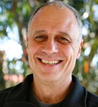
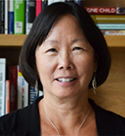
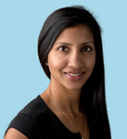
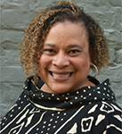
Funder Perspectives
Moderator
John Gomperts
Executive Fellow
Campaign for Grade-Level Reading
Discussant
Barbara Chow
Heising-Simons Foundation
Discussant
Anu Malipatil
Overdeck Foundation
Discussant
Brenda Blasingame
J.B. and M.K. Pritzker Family Foundation
7

Slide 8
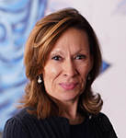
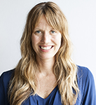
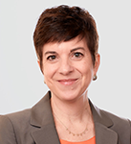
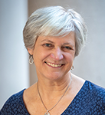
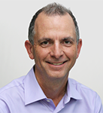
Program Leader Perspectives
Moderator
Yolie Flores
National Campaign Director
Parent Nation at TMW Center for
Early Learning + Public Health
The University of Chicago
Discussant
Michelle Torgerson
Raising A Reader
Discussant
Naila Bolus
Jumpstart
Discussant
Nikki Shearman
Reach Out and Read
Discussant
Stephen Hannon
LENA
8

Slide 9
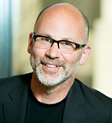
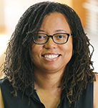
Research and Evaluation Perspectives
Discussant
Phil Fisher
Director
University of Oregon Center for Translational Neuroscience
Science Director
National Forum on
Early Childhood Policy and Programs
Discussant
Nicole Patton Terry
Director
Florida Center for Reading Research
Deputy Director
Regional Education Lab-Southeast
Florida State University
9

Slide 10
Momentum Continues to Build!
Since its launch in 2012, the GLR Communities Network has grown to include more than 350 communities, representing 46 states, the District of Columbia, Puerto Rico, the U.S. Virgin Islands and two Canadian provinces — sponsored by 5,200+ local organizations, institutions and agencies and supported by 500+ state and local funders, including 200+ United Ways.
A Wide Reach
The GLR Network encompasses 400+ U.S. counties. These diverse rural and urban communities are home to 17.7 million children ages 0–9, 44.2% of all children in this age group, and 43.8% of students in grades K–3. Across the Network, almost one-quarter of residents under 18 live in poverty.
gradelevelreading.net @readingby3rd #GLReading #LearningTuesdays

Slide 11
Poll on the Confidence Question
How confident are you that the children of economically challenged, fragile and marginalized families are receiving the services to which they are entitled, in a manner that’s properly sequenced, at the appropriate dosage and for the necessary duration?
Very confident / somewhat confident / not confident at all
Pre-pandemic? Today?

Slide 12
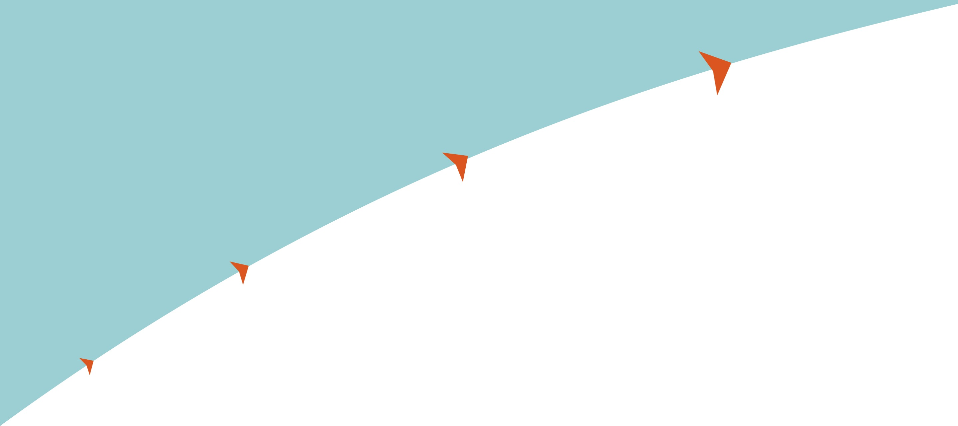
Proof points progression…
Proof points progression…
SUSTAINABLE
SCALE
GAME-CHANGING
IMPACTS
BIGGER, BETTER
OUTCOMES
MOVING THE NEEDLE

Slide 13
Listening Tour 2017–2018
69 events in
49 communities in
25 states, D.C. and Saskatchewan, Canada
27 Pacesetter communities, 16 All-America City awardees
and 2 finalists
8,300+ leaders, local funders and stakeholders (reached via small-group briefings, consultative conversations and networking events)
gradelevelreading.net @readingby3rd #GLReading #LearningTuesdays

Slide 14
The unacknowledged challenge…
NO CONFIDENCE
+
that low-income children will have access to needed services and supports delivered in the correct sequence (scaffolding) and at the appropriate dosage and for the necessary duration.
NO PLAN
=
to fix the “last mile” challenges: chaotic delivery of services and supports, inconsistent access to the data needed to inform decisions, limited visibility on what’s working where.
NO CHANCE
for gap-closing and game-changing progress.

Slide 15
Our Shared Aspiration?
Enhance the prospects for bigger, better outcomes, gap-closing and game-changing impacts by encouraging / supporting / incentivizing the migration away from our existing program-by-program / model-by-model approach to a more collaborative practice that allows context-specific aggregation of effort.

Slide 16
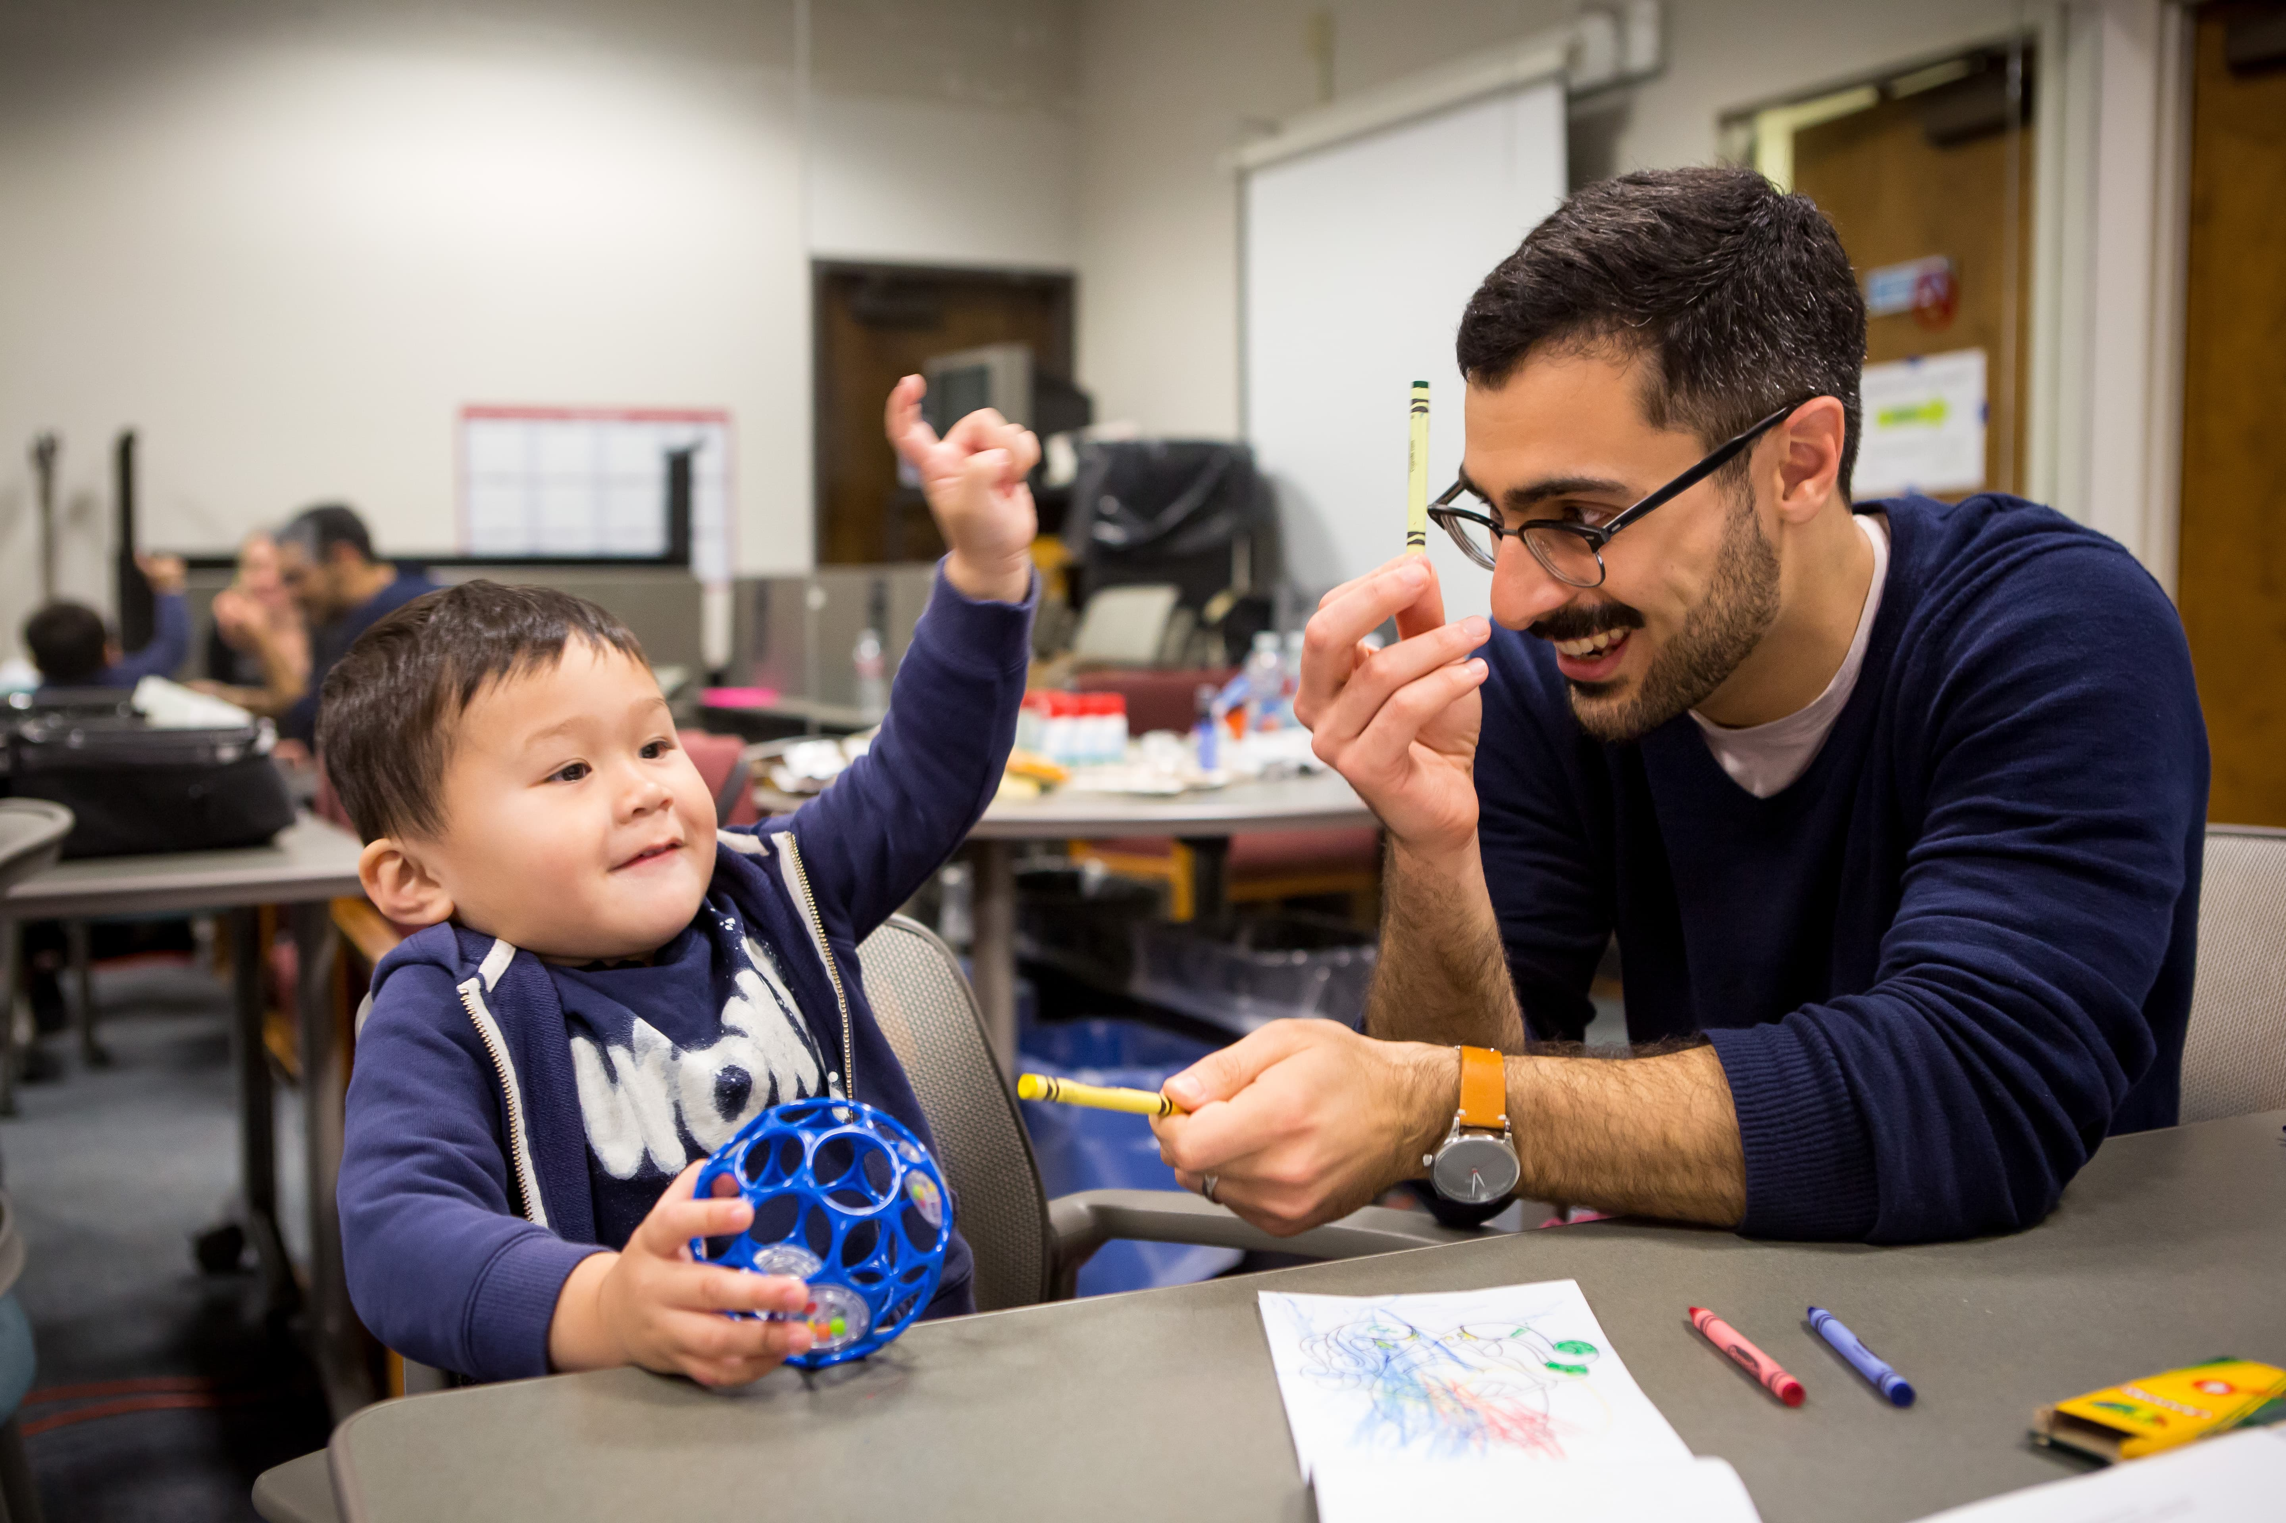
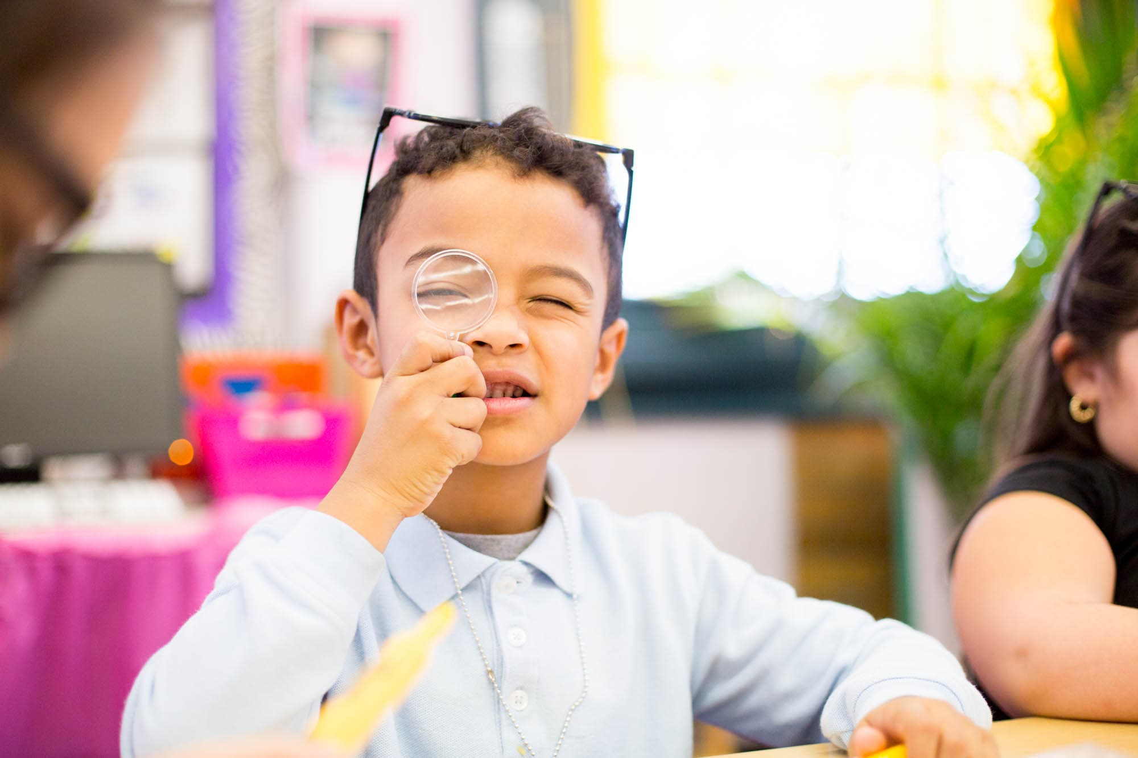
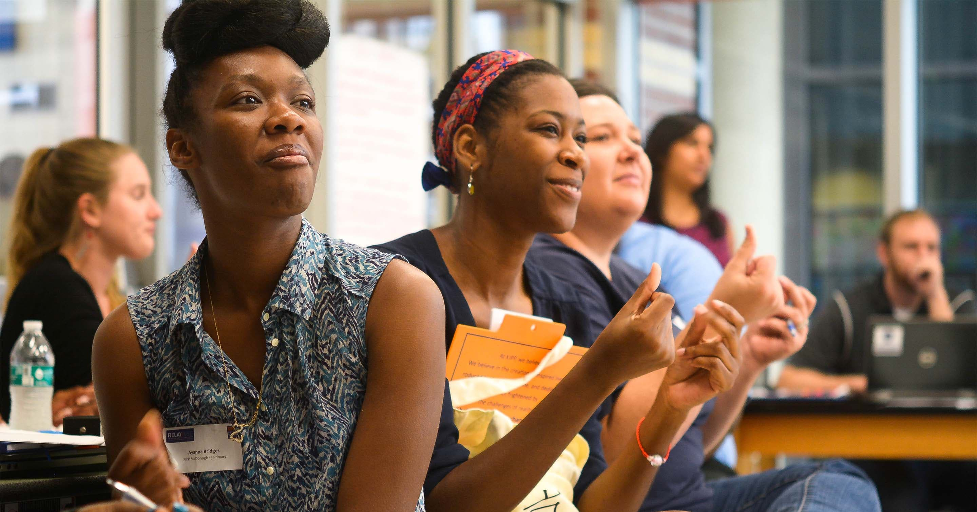
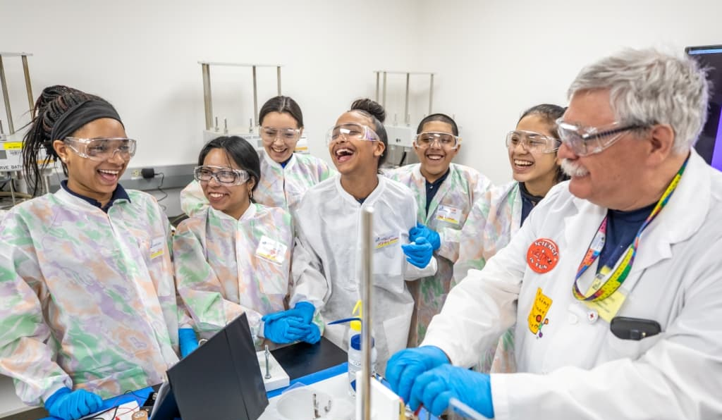
OFF Aspirational Mission
We seek to open doors for every child in the U.S. by measurably enhancing education both inside and outside the classroom.

Slide 17
"The key to your success will not be your ability to stand alone and distinguish yourself, but [will be] your ability to work with others, your ability to co-create those strategies that will get you solutions," he says. "It requires you to think about ownership of something not as being simply yours but as a public good and that what you're trying to do is bring more investors into this public good."
- Darren Walker, President of Ford Foundation

Slide 18
Philanthropy’s Role in Supporting Collaboration
Impact in the World
Grow Reach / Strengthen Impact
Build Community / Skills
Grow Pool of Investors

Slide 19


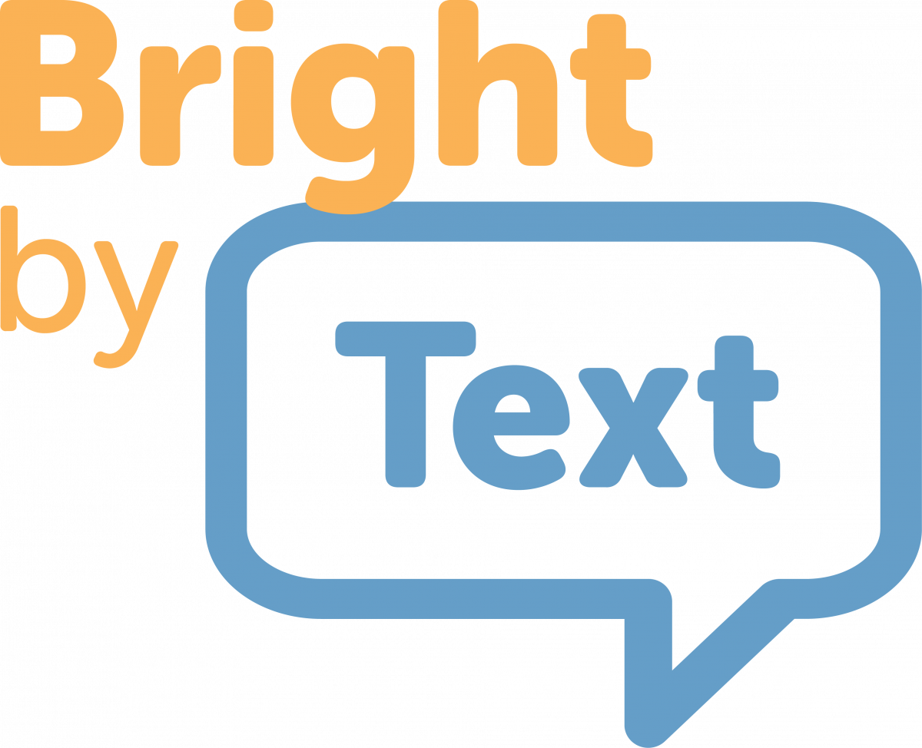




Philanthropy’s Role in Supporting Collaboration
Grow Reach / Strengthen Impact
Grow Reach
Align Measurement
Co-design Research
Partner “ecosystem” grantees with grantees doing impactful work to create meaningful sector connections
Leverage a trusted research group to provide technical assistance to a group of organizations / grantees to strengthen their measurement capabilities
Bring together grantees to co-design a shared research agenda to understand impact and build a community for ongoing learning / R+D

Slide 20




Philanthropy’s Role in Supporting Collaboration
Build Community / Skills
Convene
Assist
Bring together grantees to understand and work together on shared problems
Host grantee convenings
Structured consultancies around strengths / gaps
Assess grantee opportunities for skill building and match with technical providers in a community based environment

Slide 21
Philanthropy’s Role in Supporting Collaboration
Grow Pool of Investors
Promote / Influence
Leverage Overdeck’s platform, voice, and access to help grantees build megaphone
Host webinars / conferences to spotlight grantee work
Feature grantees in blogs, newsletters, social
Highlight grantee work through third party events / conferences (GFE, CGLR)
Engage in funder to funder conversations

Slide 22
State Events
Visit our new conference site to find out how dozens of states and communities confronted by COVID-19 stepped up to meet the moment.
http://glrweek2021.gradelevelreading.net/state-events/

Slide 23
Plenary Sessions
A Virtual Gratitude Reception: CGLR Salutes Our Partners
Monday, July 26, 2021, 3–4:30 p.m. ET
Meeting the Moment: Accelerating Equitable Recovery and Transformative Change
Tuesday, July 27, 3–4 p.m. ET
Co-sponsored by Education Week and hosted on the On24 platform
Bringing Digital Equity Home: The Suncoast Digital Access for All Initiative
Wednesday, July 28, 3–4:30 p.m. ET – A Crucible of Practice Salon
The CARE Fund: A Philanthropic Initiative to Meet the Moment
Co-Sponsored by United Philanthropy Forum
Thursday, July 29, 3–4:30 p.m. ET – A Funder-to-Funder Conversation
Assume Collaboration: A Consultative Conversation on Aggregating for Impact
Friday, July 30, 2:30–4 p.m. ET (invitation only)

Slide 24
Afterwords
4:00–4:30 PM
A town hall-style crowdsourcing conversation around topics, issues and challenges CGLR should have on the list of things to explore for the year-long consultative conversation “Aggregating for Impact.”
Please join us if your schedule allows.

Slide 25


@readingby3rd
@CampaignforGLR
#GLRKeepers
GLRWeek2021.gradelevelreading.net

