Slide 1

Plenary Title Goes Here
Housekeeping Tips
Please introduce yourself in the Chat box
All attendees are participating in Listen Only mode
Post your questions in the Q&A box
Webinar is being recorded & will be made available
Webinar is also being live-streamed on Facebook
All resources linked in the chat will be shared in a follow-up email
Follow the conversation on Twitter and LinkedIn, using #GLRWeek #BrightSpotsSilverLinings and tag us @readingby3rd
Please take the brief evaluation survey posted at the end of the session
We are offering live ASL interpretations services for this session. You will see the interpreters on your screen for the duration of this session. Please remember to speak one at a time in group situations and speak slowly and clearly.

Slide 2


GLRWeek2022.gradelevelreading.net / #GLRWeek #BrightSpotsSilverLinings

Slide 3
Plenary Sessions
A Virtual Gratitude Reception: CGLR Salutes Our Public Libraries
Monday, July 18, 3–4:30 p.m. ET
Building Blocks for the New Normal: Mining the Bright Spots and Silver Linings
Tuesday, July 19, 3–4:30 p.m. ET
$65B to advance digital equity: Leverage challenges & opportunities for state & local funders
Wednesday, July 20, 3–4:30 p.m. ET
Community Coalition Leading Organizations: Celebrating Community and Cultivating Resilience
Thursday, July 21, 3–4:30 p.m. ET
Assume Collaboration: The Consultative Conversation on Aggregating for Impact Continues﻿
Friday, July 22, 2–3:30 p.m. ET (invitation only)

Slide 4




@readingby3rd
@CampaignforGLR
@CampaignforGLR
#GLRWeek
#BrightSpotsSilverLinings
GLRWeek2022.gradelevelreading.net

Slide 5

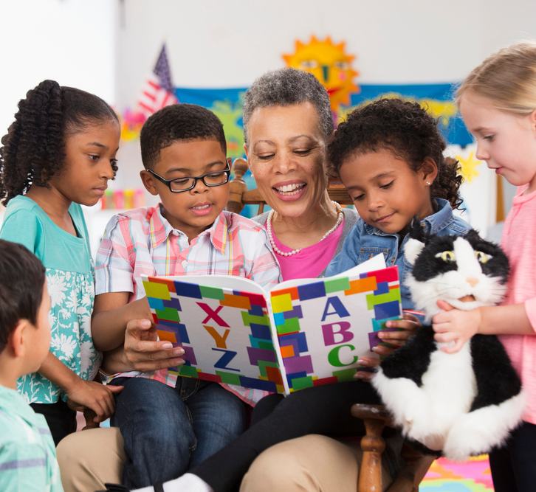
Assume Collaboration
A Consultative Conversation on Aggregating for Impact
Friday, July 30, 2:30–4 PM ET
GLRWeek2022.gradelevelreading.net / #GLRWeek #BrightSpotsSilverLinings

Slide 6
Co-Discussant
First Name Last Name
Title
Organization
Moderator
First Name Last Name
Title
Organization
Co-Discussant
First Name Last Name
Title
Organization
Co-Discussant
First Name Last Name
Title
Organization
Co-Discussant
First Name Last Name
Title
Organization
Co-Discussant
First Name Last Name
Title
Organization
GLRWeek2022.gradelevelreading.net / #GLRWeek #BrightSpotsSilverLinings
6

Slide 7
Presenters slides insert here.

Slide 8
State Events
Visit our new conference site to find out more information
http://glrweek2022.gradelevelreading.net/state-events/

Slide 9
Plenary Sessions
A Virtual Gratitude Reception: CGLR Salutes Our Public Libraries
Monday, July 18, 3–4:30 p.m. ET
Building Blocks for the New Normal: Mining the Bright Spots and Silver Linings
Tuesday, July 19, 3–4:30 p.m. ET
$65B to advance digital equity: Leverage challenges & opportunities for state & local funders
Wednesday, July 20, 3–4:30 p.m. ET
Community Coalition Leading Organizations: Celebrating Community and Cultivating Resilience
Thursday, July 21, 3–4:30 p.m. ET
Assume Collaboration: The Consultative Conversation on Aggregating for Impact Continues﻿
Friday, July 22, 2–3:30 p.m. ET (invitation only)

Slide 10
@readingby3rd
@CampaignforGLR
@CampaignforGLR
#GLRWeek
#BrightSpotsSilverLinings
GLRWeek2022.gradelevelreading.net

